Slide 1
Lab 5 STACK
CSC-221
Engr. Ayesha Khan
Data Structure and Algorithms

Slide 2
Stacks
A stack is an Abstract Data Type (ADT), commonly used in most programming languages
Stack ADT allows all data operations at one end only. At any given time, we can only access the top element of a stack.
This feature makes it LIFO data structure. LIFO stands for Last-in-first-out. Here, the element which is placed (inserted or added) last, is accessed first.
In stack terminology, insertion operation is called PUSH operation and removal operation is called POP operation.

Slide 3
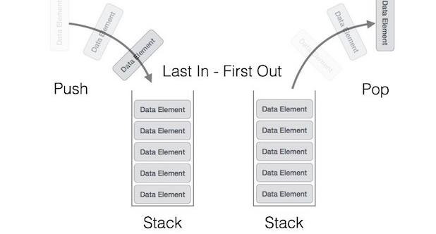
Stack Representation

Slide 4
Implementation of Stack
A stack can be implemented by means of Array, Structure, Pointer, and Linked List.
Stack can either be a fixed size one or it may have a sense of dynamic resizing.
Here, we are going to implement stack using arrays, which makes it a fixed size stack implementation.

Slide 5
Basic Operations Of Stack
To use a stack efficiently, we need to check the status of stack as well. For the same purpose, the following functionality is added to stacks −
peek() − get the top data element of the stack, without removing it.
isFull() − check if stack is full.
isEmpty() − check if stack is empty.

Slide 6
Basic Operations of Stack
Stack operations may involve initializing the stack, using it and then de-initializing it. Apart from these basic stuffs, a stack is used for the following two primary operations −
push() − Pushing (storing) an element on the stack.
pop() − Removing (accessing) an element from the stack.

Slide 7
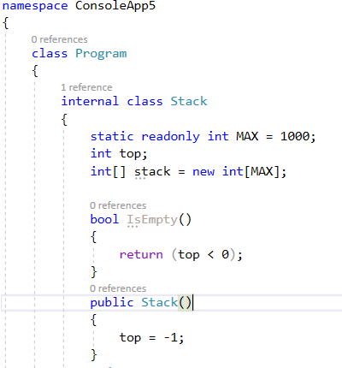
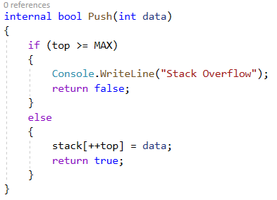
BASIC METHODS IMPLEMENTATION:

Slide 8
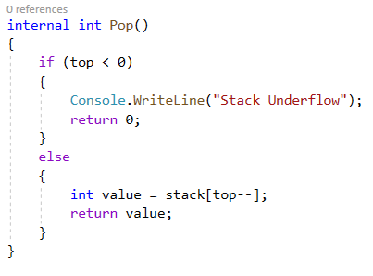
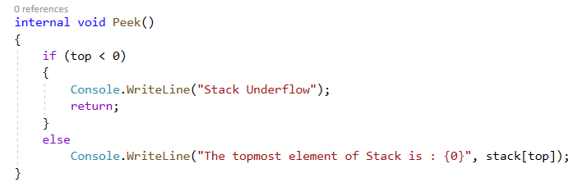
BASIC METHODS IMPLEMENTATION:

Slide 9
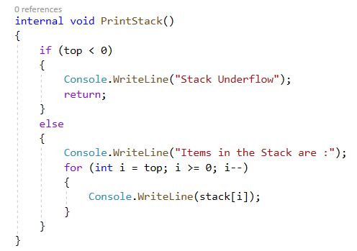
BASIC METHODS IMPLEMENTATION:

Slide 10
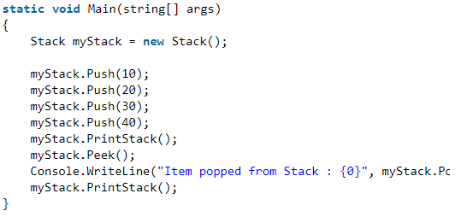
BASIC METHODS IMPLEMENTATION:

Slide 11
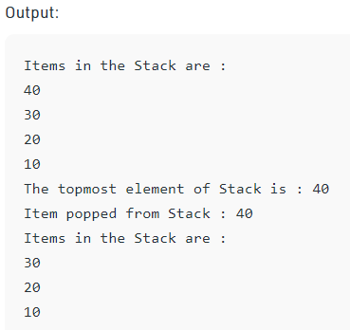
BASIC METHODS IMPLEMENTATION:

Slide 12
Lab Tasks
Write a program to build your own stack class. The minimum your stack class should include is using your enrollment no :
A Push(Object) method
A Pop() method
A Peek() method
A IsFull() method
A IsEmpty() method
A Display() method
A Count() method

Slide 13
Thank You

